Slide 1
Lesson objective
PBiS focus:
Respect – listening
Achieve – attempt all tasks
Title: Linear fluency
Aim – be able to:
Draw the next spatial pattern
Create a rule and plot from a table of values
Plan:
Review parallel lines
Spatial patterns
Need whiteboards and calculators.

Slide 2
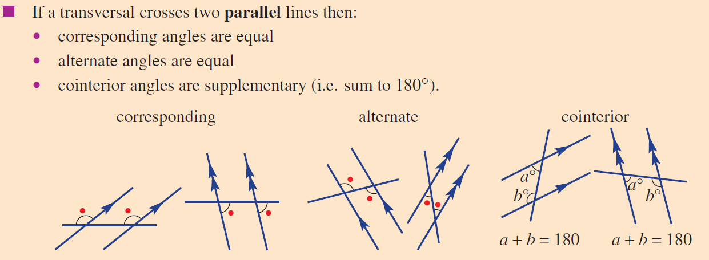
3 relationships in parallel lines

Slide 3







What is the angle?
Whiteboards
$$70°$$
B
A
$$50°$$
50$°$
$$65°$$
D
$$70°$$
C
$$E$$
$$90°$$

Slide 4
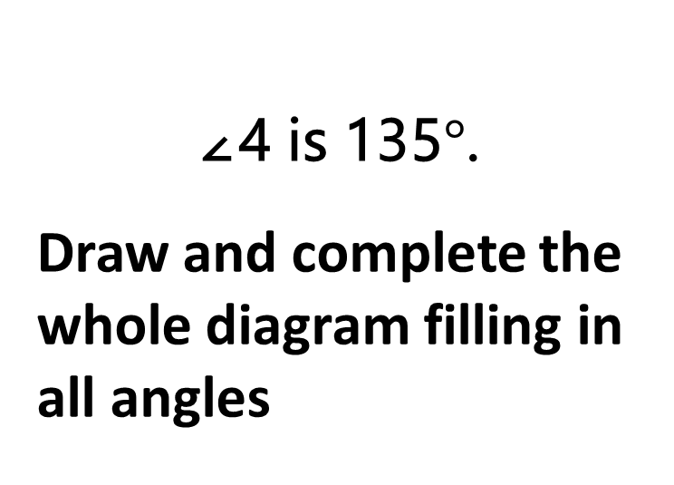
Whiteboards
I do
∠4 is 135$°$.
Draw and complete the whole diagram filling in all angles
1
2
3
4
5
6
7
8

Slide 5
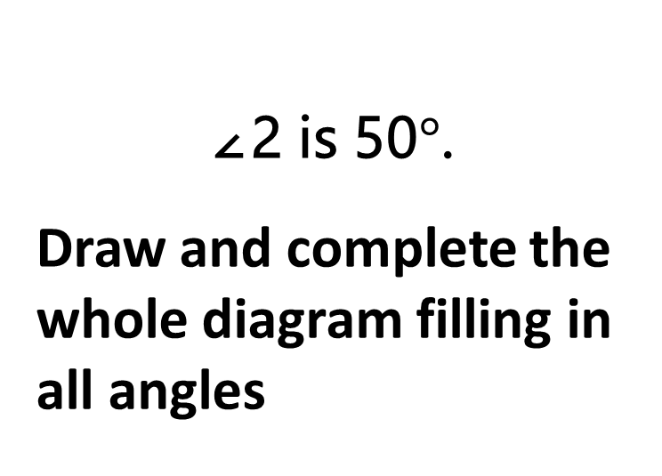
Whiteboards
2 minutes
∠2 is 50$°$.
Draw and complete the whole diagram filling in all angles
1
2
3
4
5
6
7
8

Slide 6
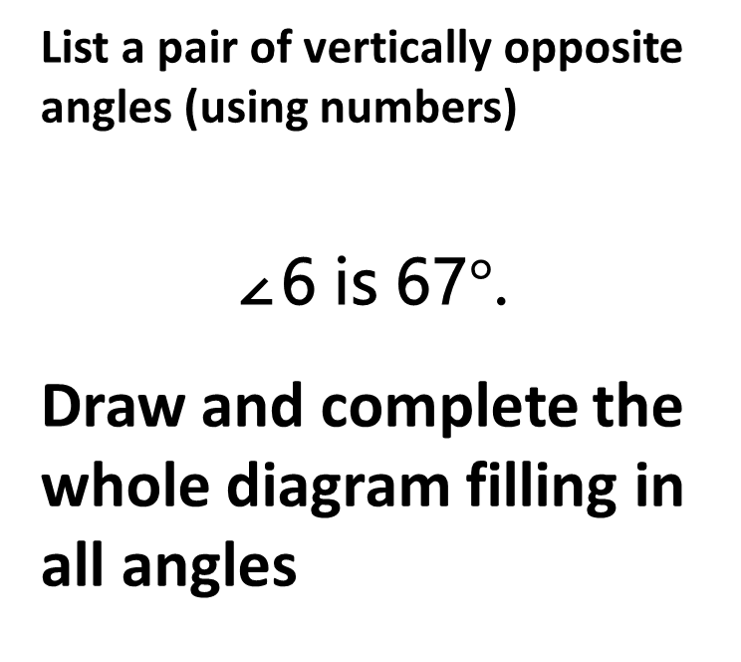
Whiteboards
2 minutes
List a pair of vertically opposite angles (using numbers)
∠6 is 67$°$.
Draw and complete the whole diagram filling in all angles
1
2
3
4
5
6
7
8

Slide 7

Daily review
Draw the next pattern in the sequence

Slide 8

Daily review
Draw the next pattern in the sequence

Slide 9
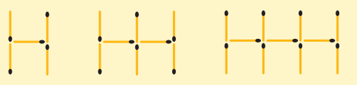
Daily review
Draw the next pattern in the sequence

Slide 10
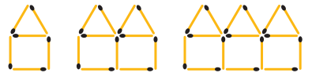
Daily review
Draw the next pattern in the sequence

Slide 11
Finish this table of values
Number of shapes | 1 | 2 | 3 | 4
Number of matches | 6

Slide 12
Start to finish - demo
What we should be able to do:
Draw the next shape
Make a table of values
Create a rule
Determine 20th pattern
Plot

Slide 13
Demonstration
Make a table of values
Create a rule
Determine 20th pattern
Number of shapes | 0 | 1 | 2 | 3 | 4
Number of matches
Rule:
When the number of shapes = 20, the number of matches will = _________

Slide 14
Your turn
Complete a table of values
Create a rule
Determine 20th pattern
Number of shapes | 0 | 1 | 2 | 3 | 4
Number of matches
Rule:
When the number of shapes is 20, the number of matches will = _________

Slide 15
Your turn
Complete a table of values
Create a rule
Determine 20th pattern
Number of shapes | 0 | 1 | 2 | 3 | 4
Number of matches
Rule:
When the number of shapes is 20, the number of matches will = _________

Slide 16
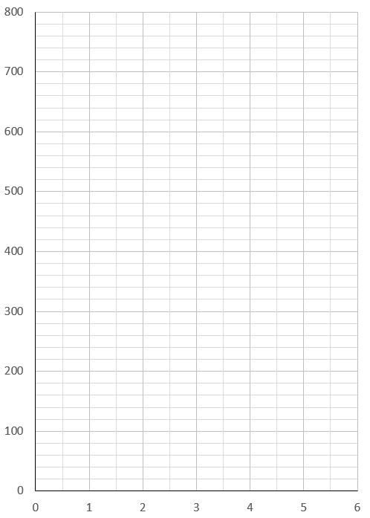
Describing graphs
This graph shows how much Sally is paid.
How much is she paid per hour?
Hours | 1 | 2 | 3 | 4 | 5 | 6
$$

Slide 17
Describing graphs
Tasha is a sparky and the following graph shows how much she charges.
Determine her hourly rate and call out fee
Rule:
Hourly rate:
Call out fee:
Hours | 0 | 1 | 2 | 3 | 4
$$

Slide 18
Individual practice
Page 124
Questions 1 – 12
In your exercise book

